Slide 1
SHINCHON Simulation for Heavy IoN Collision with Heavy-quark and ONia Sanghoon Lim PNU 2020/Apr/16

Slide 2
MC simulation for heavy quarks
Heavy quarks are mostly produced in the early stage of HI collisions
Inside full evolution of the QGP
There are several theoretical frameworks for HQ considering radiative and collisional energy loss
Successfully describe D-meson R_{AA} and v₂ simultaneously in HI collisions
MC for heavy quarks will be useful to compare with the data more differentially
Angular correlation, jet sub-structure, and others
JHEP 10 (2018) 174

Slide 3
New results on B→μ flow
New results on charm and bottom muon flow (arXiv:2003.03565)
Non-zero v₂ for bottom muon
Smaller bottom muon v₂ than charm muon v₂ at lower p_{T} but similar at higher p_{T}
Can be covered by ALICE

Slide 4
MC simulation for heavy quarks
Heavy quarks are mostly produced in the early stage of HI collisions
Inside full evolution of the QGP
There are several theoretical frameworks for HQ considering radiative and collisional energy loss
Successfully describe D-meson R_{AA} and v₂ simultaneously in HI collisions
MC for heavy quarks will be useful to compare with the data more differentially
Angular correlation, jet sub-structure, and others
More things to understand in small collision systems…
Phys. Rev. Lett. 121, 082301 (2018)
JHEP 12 (2019) 092

Slide 5
General procedure (e.g. JETSCAPE)
Initial geometry
Translation or MC
Hydro evolution
Medium response
Hadronization
Hadronic interaction
https://indico.cern.ch/event/792436/contributions/3570550/

Slide 6
General procedure (e.g. JETSCAPE)
https://indico.cern.ch/event/792436/contributions/3570550/

Slide 7
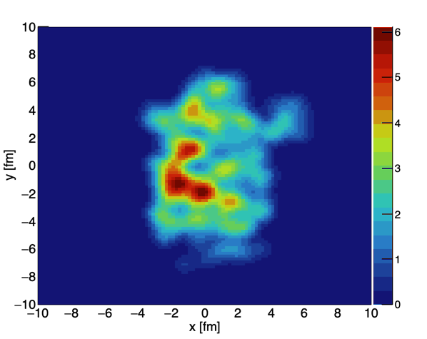
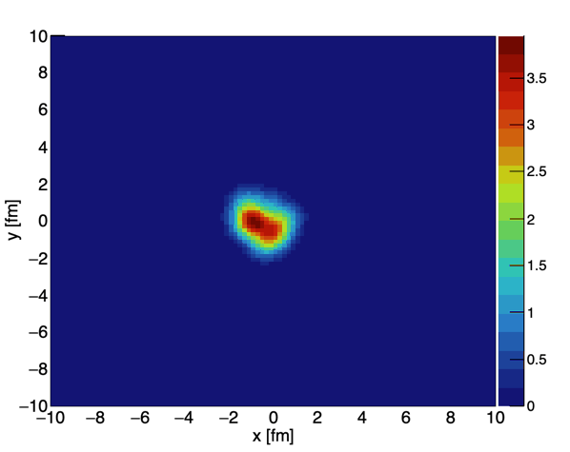
Initial condition
MC Glauber
2D distribution of smeared wounded nucleons in transverse direction
For hydrodynamics simulation, should convert into energy density by multiplying a scale factor
The scale factor is tuned to match the measured charged particle multiplicity
IP-Glasma
Gluon field starting from MC Glauber initial condition
Time evolution considering weak coupling of gluons
This is possibly related to the bulk viscosity
Requires another set of scale factor to matched the measured charged particle multiplicity
MC Glauber Pb+Pb 6-8 fm
MC Glauber p+Pb 0-2 fm
IP-Glasma Au+Au 6-8 fm

Slide 8
Hydrodynamic simulation
SONIC
2+1D hydrodynamic simulation
https://sites.google.com/site/revihy/home
Option for pre-hydrodynamic evolution based on AdS/CFT (called superSONIC)
Interfaced with the B3D hadronic cascade code
Pb+Pb 6-8 fm
p+Pb 0-2 fm

Slide 9
Hydrodynamic simulation
SONIC
2+1D hydrodynamic simulation
https://sites.google.com/site/revihy/home
Option for pre-hydrodynamic evolution based on AdS/CFT (called superSONIC)
Interfaced with the B3D hadronic cascade code
MUSIC
2+1D or 3+1D hydrodynamic simulation
http://www.physics.mcgill.ca/music/
Recommended to use IP-Glasma initial condition
From the recent update, there is no longer an option with MC Glauber
Hydrodynamic evolution works well but need additional work for validation
Will be useful to test bulk viscosity effect and longitudinal expansion

Slide 10
HQ diffusion
Reference
Phys. Rev. C 90, 024911 (2014)
Initial HQ distribution
Spatial distribution from the MC Glauber initial condition
p_{T} distribution from FONLL/PYTHIA
Medium response
Follow time-dependent temperature/energy density profile from hydrodynamic simulation
Drag and diffusion based on Langevin equation
No coalescence
Pb+Pb 6-8 fm
Charm quark

Slide 11
HQ diffusion (charm quark)
p+Pb 0-2 fm
Charm quark
Pb+Pb 6-8 fm
Charm quark

Slide 12
HQ diffusion (charm vs bottom)
Pb+Pb 6-8 fm
Charm quark
Pb+Pb 6-8 fm
Bottom quark

Slide 13
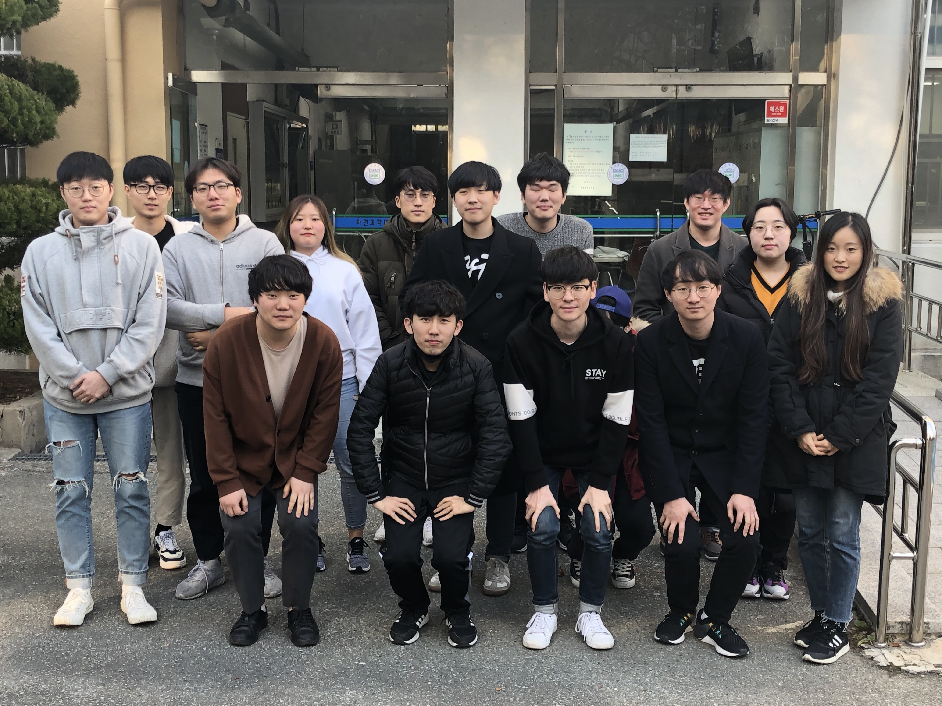
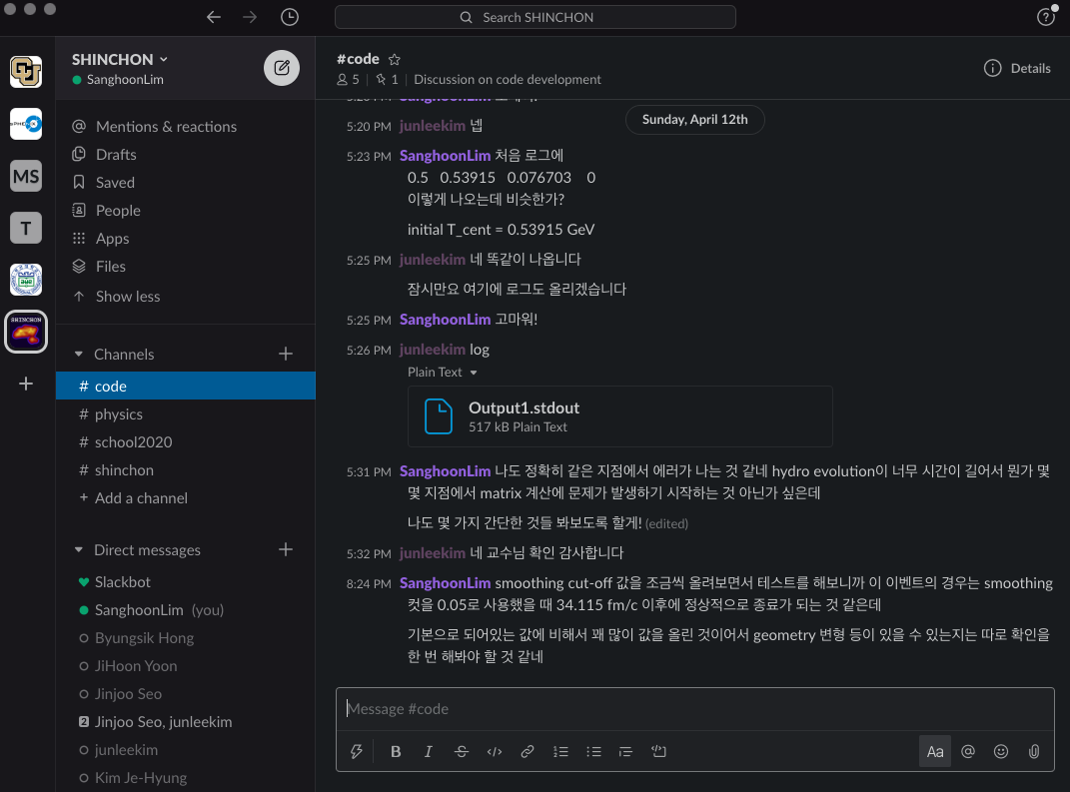
SHINCHON School in 2020/Jan
SHINCHON School at PNU
~15 participants to learn basic software/code for MC simulation MC Glauber, IP-Glasma, SONIC, MUSIC, HQ diffusion
indico page: https://n-ext.inha.ac.kr/event/382/
Instruction slides: https://docs.google.com/presentation/d/1qxnRDLZ_hsXlv39KJ8kSWfxR7fegsIeYogIX0ZzH6Qk/edit?usp=sharing
Git repository https://github.com/sh-lim/SHINCHON
Slack workspace mcshinchon.slack.com

Slide 14
Discussion with J.H. Hong
Currently, the theoretical calculation procedure is not suitable for even-by-event MC
Phys. Lett. B 801 (2020) 135147

Slide 15
Discussion with J.H. Hong
Currently, the theoretical calculation procedure is not suitable for even-by-event MC
Phys. Lett. B 801 (2020) 135147

Slide 16
Discussion with J.H. Hong
For initial study, plan to implement
Time-dependent temperature profile from 2+1D hydrodynamic simulation
Time-dependent b-quark dN/dp_{T} from Langevin framework
Study in different centrality of different initial geometry, medium property, and b-quark density
3+1D with MUSIC?
From lecture slides at the school
Phys. Lett. B 801 (2020) 135147

Slide 17
Another approach
Reproduce the nuclear modification factor in MC (medium from hydro simulation)
Sample temperature dependent thermal width based on hydro simulation
Calculate disassociation rate (R_{AA}) at different time

Slide 18
Current status
Set up the general MC framework in the KISTI computing farm for ALICE
Tested sources have been added into the github repository
Bi-weekly meeting for code development
Wed. 2:00 pm
Participants: 박재범(고려대), 김준이(전북대), 서진주(인하대)
Working on tuning the MC configuration for Pb+Pb collision at the LHC energies
Phys. Rev. Lett. 116, 222302 (2016)
Done by Junlee Kim
scaler from MC Glauber to SONIC input
N_{part} dependence in SONIC

